Slide 1
Respiratory infectious disease (part 2 : pneumonia)
Dr ramin sami
مهر ماه 1401
برای شنیدن توضیحات در هر اسلاید بر روی آیکون صدا کلیک کنید

Slide 2
laboratory investigation
CBC
CRP
PCT
Biochemistry
LDH
VBG
…….

Slide 3
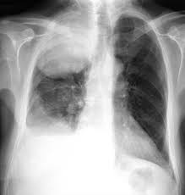
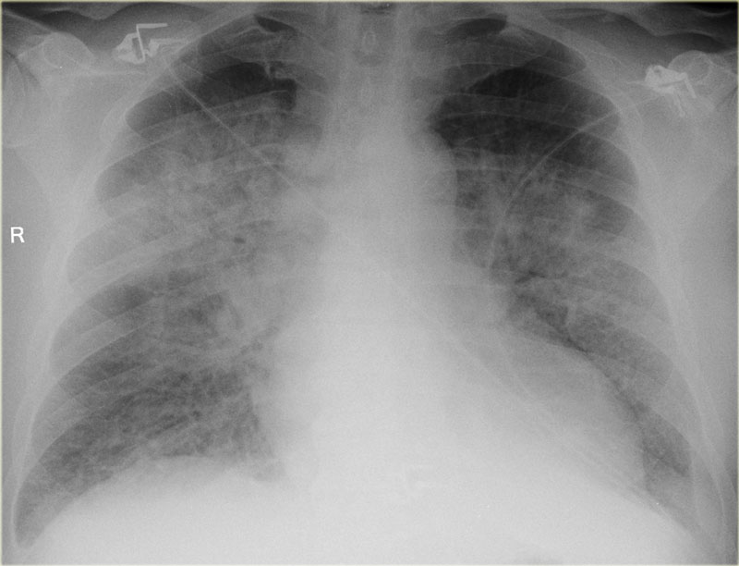
Differential diagnosis
•Pulmonary embolism
•Pulmonary hemorrhage
•Atelectasis
•Aspiration or chemical pneumonitis
•Drug reactions
•Lung cancer
•Collagen vascular diseases
•CHF
•Interstitial lung diseases

Slide 4
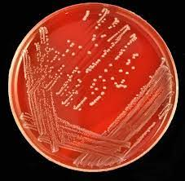
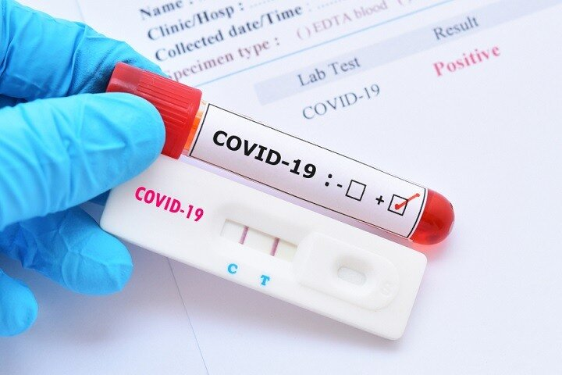
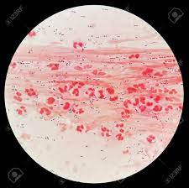
Microbiologic test
Sputum Gram stain and culture
Blood cultures
Urinary antigen testing
Immunology assay
PCR
Indication ?

Slide 5
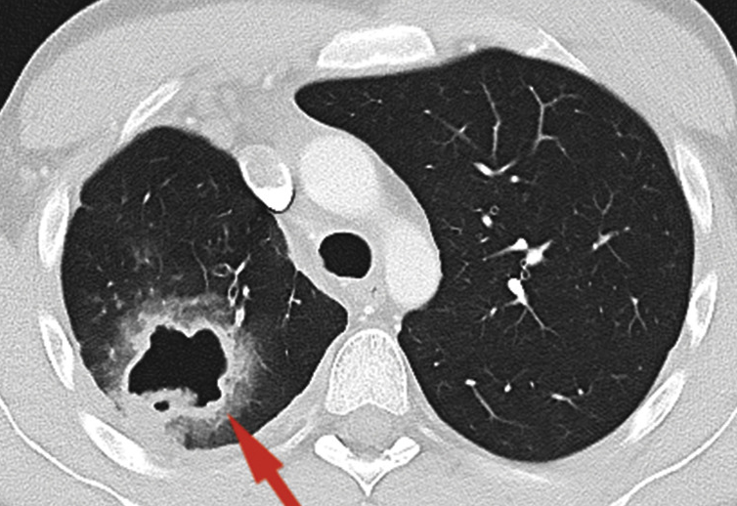
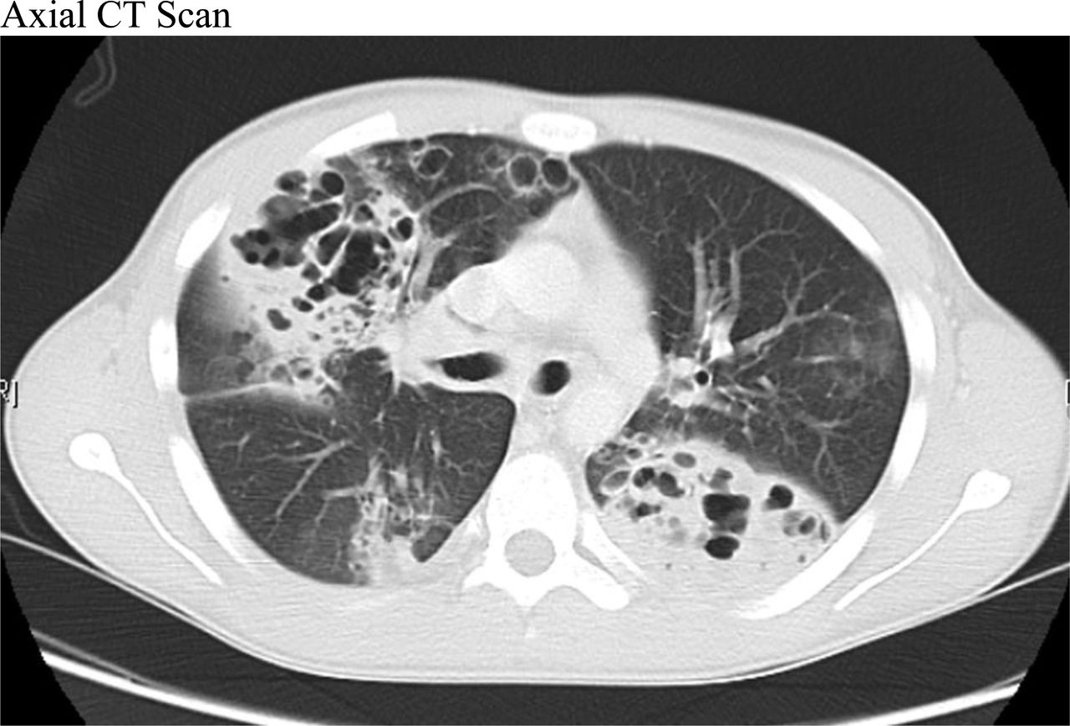
Complication (Intrathoracic)
Necrotizing pneumonia
Lung Abscess
Para pneumonic effusion
Empyema
Thoracic invasion

Slide 6
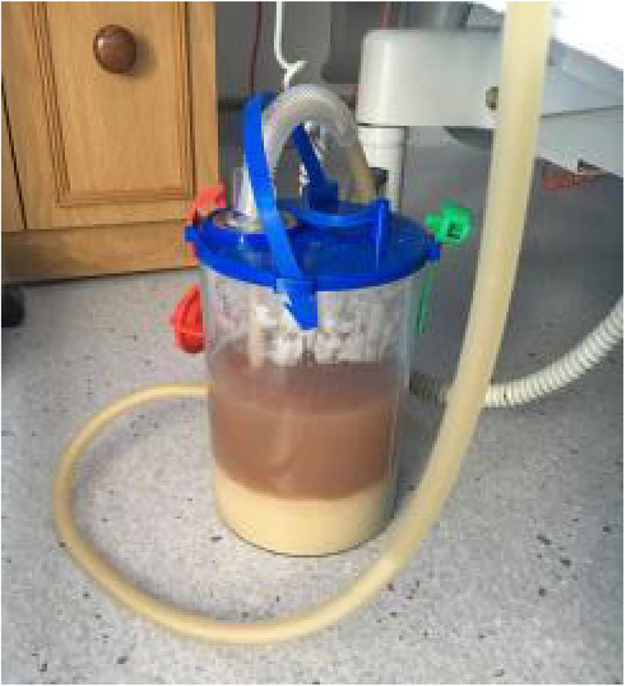
Complication (Empyema)

Slide 7
Complication (Extra thoracic)
Sepsis
Other organ involvement

Slide 8
Defining severity and site of care

Slide 9
Defining severity and site of care

Slide 10
Severity assessment
CURB-65
Confusion
Urea >7mmol/L
Respiratory rate >30
Blood pressure diastolic <60mmHg or systolic <90
≥65 years old
0-1-may be suitable for outpatient Rx
2 Hospital Rx, consider other features too (e.g. PaO₂)
≥3 Severe disease

