Slide 1
Respiratory infectious disease (part 2 : pneumonia)
Dr ramin sami
مهر ماه 1401
برای شنیدن توضیحات در هر اسلاید بر روی آیکون صدا کلیک کنید

Slide 2
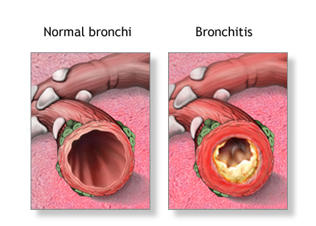
Introduction

Slide 3
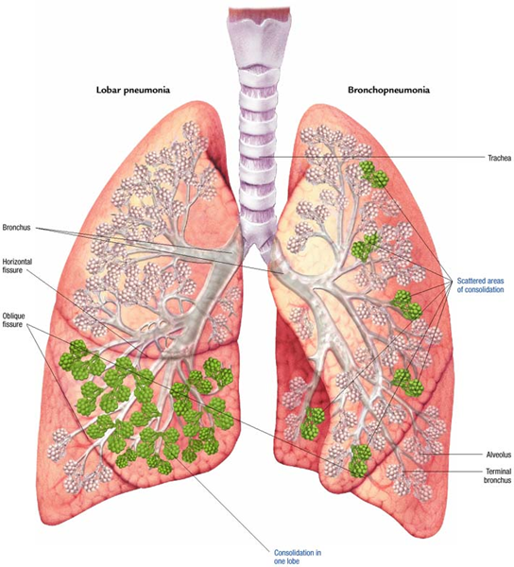
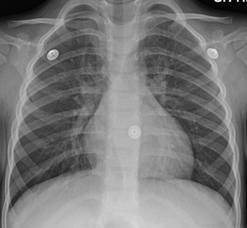
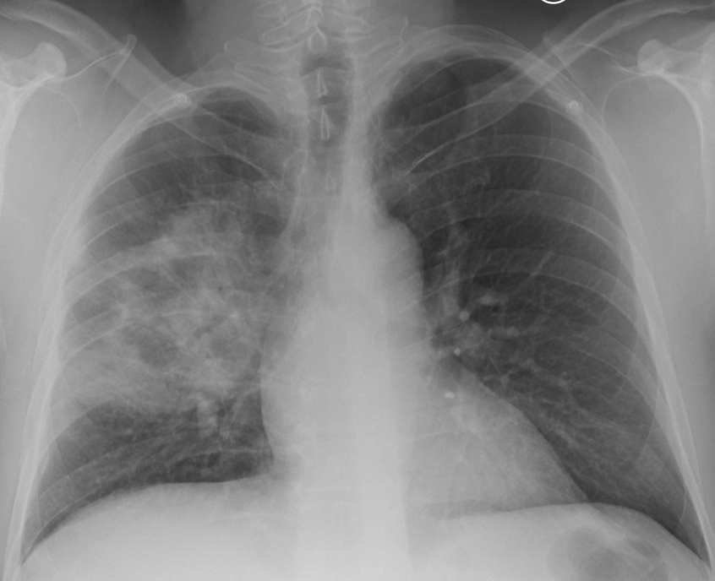
Introduction

Slide 4
Incidence
CAP is one of the most common and morbid conditions in clinical practice
In the United States, CAP accounts for over 4.5 million outpatient and emergency room visits annually, corresponding to approximately 0.4 percent of all encounters
CAP is the second most common cause of hospitalization and the most common infectious cause of death
Approximately 650 adults are hospitalized with CAP every year per 100,000
1.5 million hospitalizations each year
Nearly 9 percent of patients hospitalized with CAP will be rehospitalized due to a new episode of CAP during the same year.

Slide 6
Risk factor
Old age >65 y
Chronic comorbidity
Viral respiratory tract infection
impaired airway protection
Smoking and alcohol overuse
Other lifestyle factors

Slide 7
Pathophysiology

Slide 8
Pathophysiology

Slide 9
Symptom
Acute syndrome
Subacute syndrome
Chronic syndrome
Thoracic symptom
Systemic symptom

Slide 10
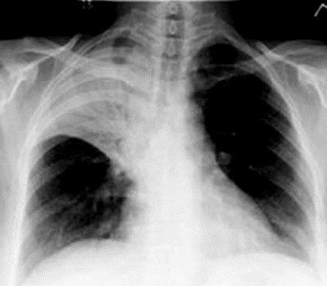
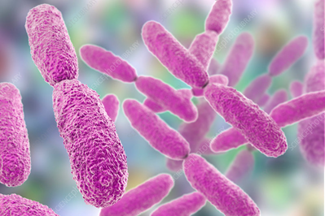
Acute pneumonia
presentation
Microbiology Imaging

Slide 11
Sub acute pneumonia
presentation
Microbiology Imaging

Slide 12
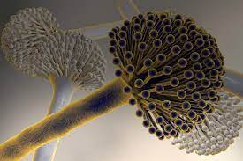
Chronic pneumonia
presentation
Microbiology Imaging

Slide 13
Extra pulmonary presentation
Constitutional
Organ presentation

Slide 14
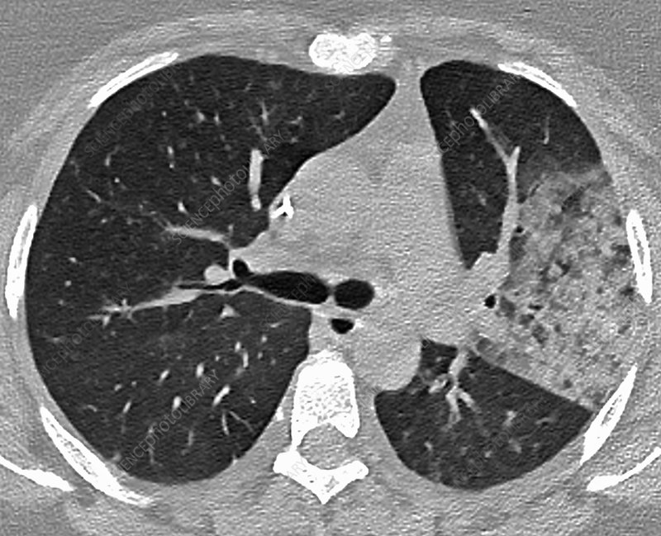
Diagnosis of pneumonia
History
Physical Exam (RR …………)
Imaging
Microbiological evaluation

Slide 15
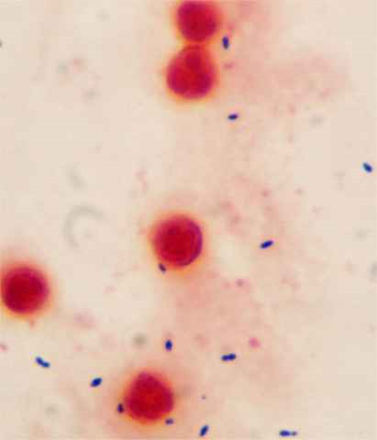
Microbiological investigation
Sputum smear
Sputum culture
Blood culture
Serology
PCR
Antigen

